Slide 1
Building A Heap – A Naïve Algorithm

Slide 2
Building A Heap – A Naïve Algorithm
Take N items from an array and build a heap.
Naïve algorithm
  For each item, insert it into a heap, which is initially empty
  public void buildHeap(T[ ] array, int size )
  {
  < initialize the heap here …>
  for( int i = 0; i < size; i++ )
  insert(array[i]);
  }
  Running time: O(log(1) + log(2) + … + log(N)), or O(NlogN)

Slide 3
An Efficient Algorithm: Build the Heap in Place
  1. Position = (numItems-2)/2; // initial position – the parent of the last item
  2. siftDown item at that position.
  3. Decrement position by one.
  4. Repeat steps 2,3,4 until position is 0.
  public void buildHeap( )
  {
  for( int i = (numItems -2)/2; i >= 0; i-- )
  siftDown( i );
  }
1
8
12
6
15
9
5
13
14
7
10
11
4
2
3
1
siftDown
starts here
8
12
6
15
9
5
Its parent
13
14
7
10
11
4
2
3
Last item

Slide 4
An Efficient Algorithm
  for( int i = (numItems -2) / 2; i >= 0; i-- )
  siftDown( i );
1
8
12
siftDown(3)
siftDown(4)
siftDown(5)
siftDown(6)
6
15
9
5
13
14
7
10
11
4
2
3

Slide 5
An Efficient Algorithm
  for( int i = (numItems -2) / 2; i >= 0; i-- )
  siftDown( i );
1
siftDown(1)
siftDown(2)
8
12
siftDown(3)
siftDown(4)
siftDown(5)
siftDown(6)
14
15
11
5
13
6
7
10
9
4
2
3

Slide 6
An Efficient Algorithm
  for( int i = numItems / 2 - 1; i >= 0; i-- )
  siftDown( i );
siftDown(0)
1
siftDown(1)
siftDown(2)
15
12
14
10
11
5
13
6
7
8
9
4
2
3

Slide 7
An Efficient Algorithm
  for( int i = numItems / 2 - 1; i >= 0; i-- )
  siftDown( i );
siftDown(0)
15
14
12
13
10
11
5
1
6
7
8
9
4
2
3

Slide 8
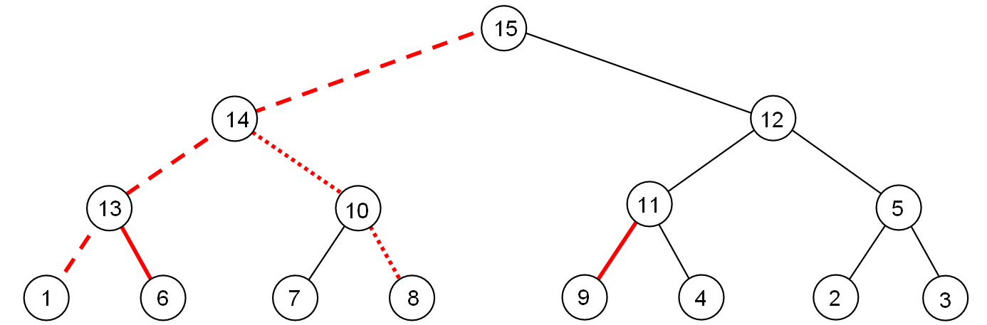
Running Time Analysis
O(NlogN) as siftDown() is called N/2 times, and each takes no more than O(logN) time.
However, this running time is not tight. The cost of BuildHeap is bounded by the number of red lines (all red lines)
  …which is at most the sum of heights of all nodes of the heap.
This sum is O(N), where N is the number of nodes in the heap.

Slide 9
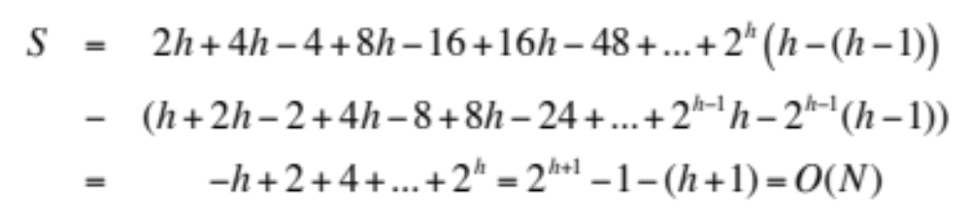
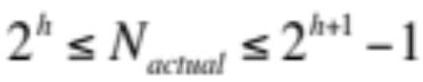
Running Time Analysis
For a perfect binary tree of height h, N = 2^{h+1}-1:
  1 node at height h
  2 nodes at height h-1
  4 nodes at height h-2
  …
  2^{h-1} nodes at height 1
  2^{h} nodes at height 0
  Total height of all nodes
Although a complete tree is not a perfect binary tree, but number of nodes in a complete tree of height h is:
Thus the actual number of nodes is within a factor of 2 of N. Hence, S = O(N_{actual})

Slide 10
Merge Two Heaps
Merge two heaps into a single one.
Append one heap to the end of the other, and then just like buildHeap, sift down the interior nodes
  Running time = O(?)

Slide 11
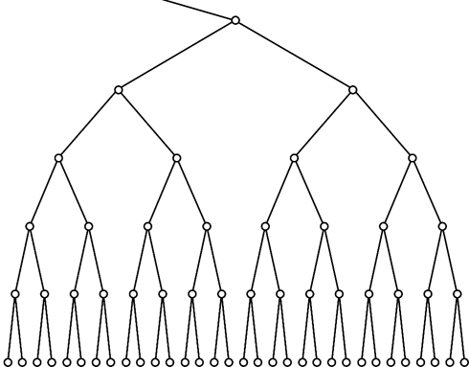
Running Time of Binary Heap Operations
Summary of the worst-case running time of binary heap operations (max-at-top)
  findMax O(1)
  removeMax() O(logN)
  insert() O(logN)
  buildHeap() O(N)
  merge() O(N)
unlikely
Even less likely
Less likely
More likely siftUp goes here

Slide 12
Applications of Heaps
EECS 233

Slide 13
Application #1: Heap-sort
Sorting algorithms: given an arbitrary array, re-position the items in the array in ascending or descending order
A naïve algorithm (we will learn more later)
It isn’t efficient (O(n²)), because it performs a linear scan to find the smallest remaining item (O(n) steps per scan).
15
7
13
5
4
6
11
16
9
4
7
13
5
15
6
11
16
9
4
5
13
7
15
6
11
16
9
4
5
6
7
15
13
11
16
9

Slide 14
Heap-Sort
Heap-sort is a sorting algorithm that repeatedly finds the largest remaining item from a heap and puts it in place.
  void heapSort(T[] arr, int numItems) {
    // Turn the array into a max-at-top heap.
    buildHeap(arr, numItems);
    int endUnsorted = numItems - 1;
    while (endUnsorted > 0) {
      // Get the largest remaining item and put it to the end
      T largestRemaining = removeMax(arr);
      arr[endUnsorted] = largestRemaining;
      endUnsorted--;
    }
  }
It is efficient:
  O(N) to turn the array into a heap
  O(log N) to remove the largest remaining item
  N above removals
  O(N log N) overall

Slide 15
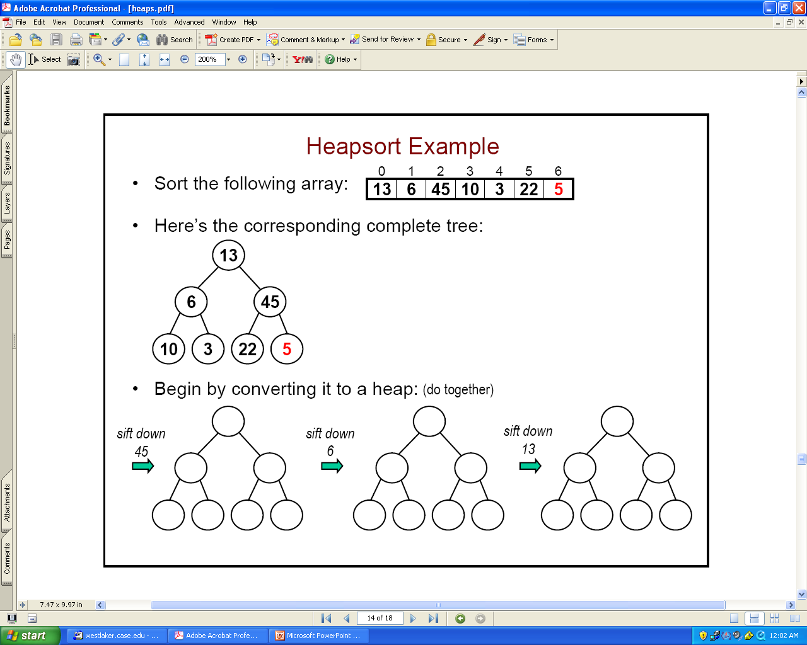
Heap-Sort Example: (1) Build the Heap
Sort this array:
The corresponding complete tree:
First call BuildHeap():
13
6
45
10
3
22
5
5
45
10
10
22
5
6
5
6
13
5

Slide 16
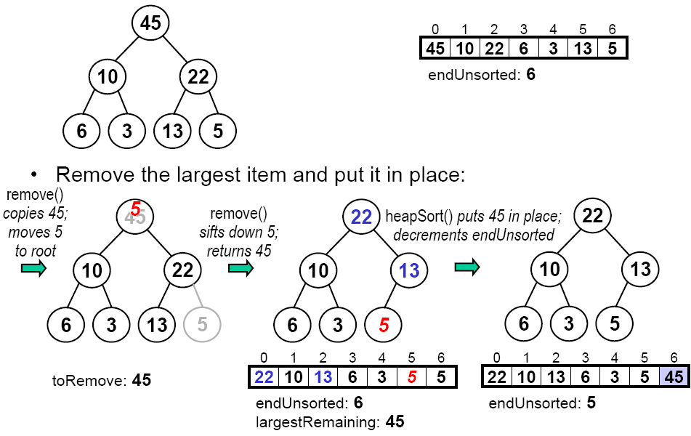
Heap-Sort Example: (2) Drain the Heap
Remove the largest item from heap:

Slide 17
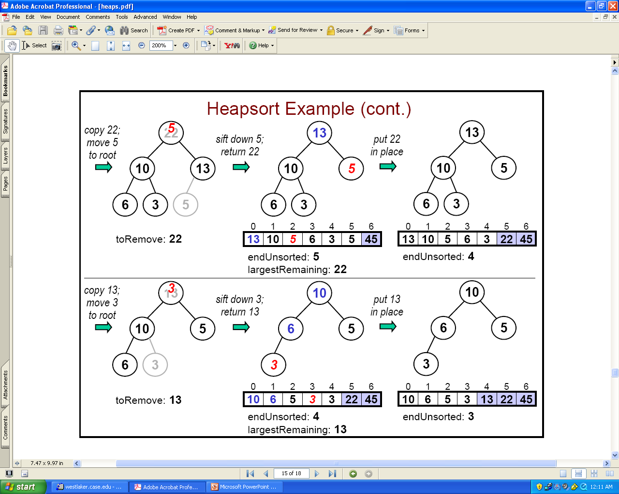
Remove the Next Largest Items

Slide 18
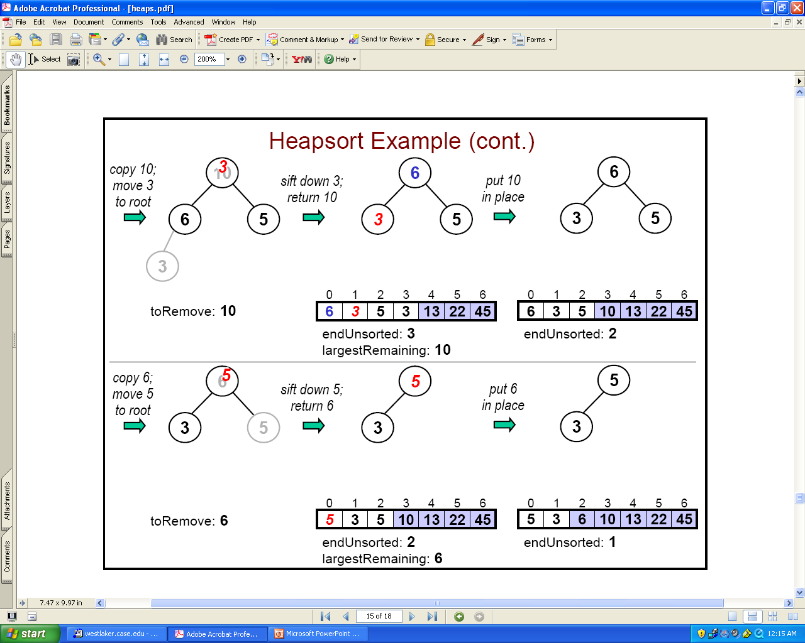
Keep Going

Slide 19
Application #2: The Selection Problem
Given a list of N items and an integer k (1 <= k <= N), find out the k-th largest item (or k largest items) in the list. E.g., N=1,000,000 and k=100, or k=N/2
Example:
  List of items: 4, 9, 0, 3, 5, 7, 10, 12, 2, 8
  12 10 9 8 7 5 4 3 2 0 (sorted order of items)
  1st largest item is: 12
  10th largest item is: 0
  6th largest item is: 5
What is your method?

